Slide 1
Impedance measurements notes
20/05/2025
Poppy Joshi

Slide 2
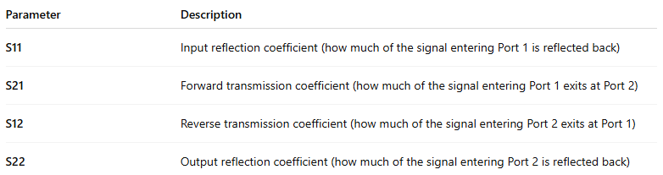
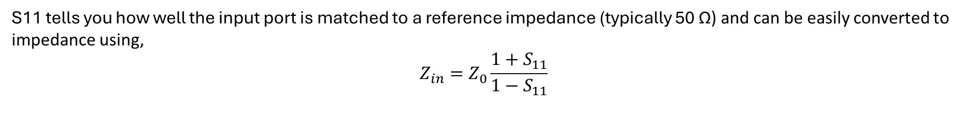
20-05-2025
S-parameters
We can measure the ‘S (scattering)-parameters’ using the the VNA which tells us information about the reflected and transmitted components (phase and amplitude) of the EM wave. We have a 2-port network, so the s-parameters measured are:
S11 tells you how well the input port is matched to a reference impedance (typically 50 Ω) and can be easily converted to impedance using,
$$Z_{in}=Z_{0}\frac{1+S_{11}}{1−S_{11}}$$

Slide 3
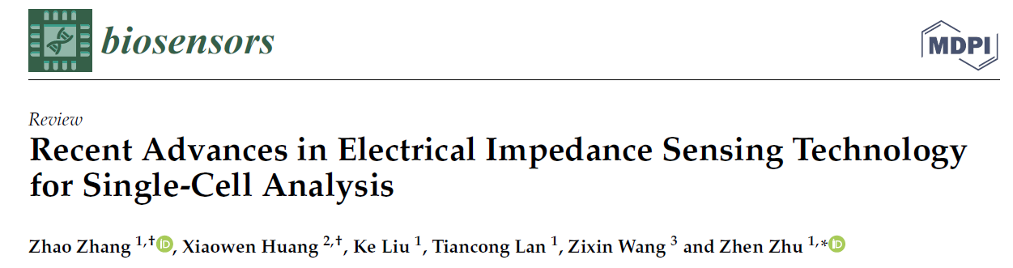
20-05-2025
Frequency ranges
https://www.mdpi.com/2079-6374/11/11/470
Frequency range of cell impedance spectra is from 1 Hz → 10 GHz, and are catagorised into 3 groups (dispersions)
α, β, γ dispersions.
α < KHz range, tells us about cell polarisation importants range for us, tricky to measure at low frequencies due to EDLs (?)
β > a few 10’s KHz, tells us about cell size, cell membrane and cytoplasm. Most commonly used
γ > GHz arises from reorientation of water molecules.
Impedence at different frequencies tells us different information:
Low frequencies (100 KHz → 1 MHz) tells us cell size
A few MHz membrane capacitance
High frequency (>> a few MHz) cyctoplasm conductivity. Cells we be dehydrated so this is N/A to us

Slide 4
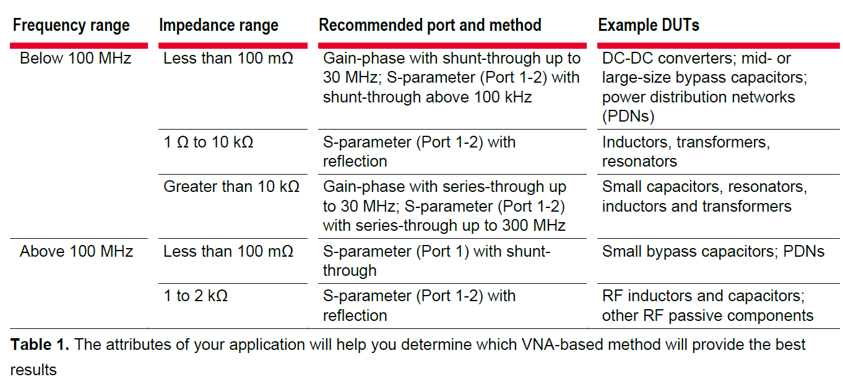
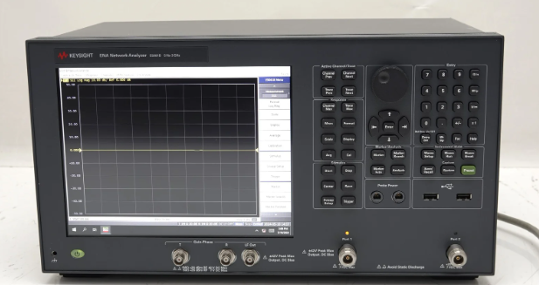

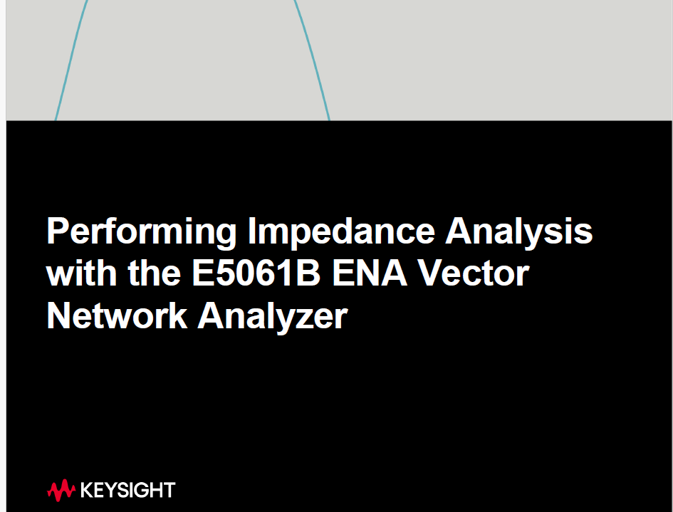
20-05-2025
Keysight E5061B ENA Vector Network Analyzer
Frequency range from 5 Hz to 3 GHz
Z_{DUT} = Impedance of the Device Under Test, 50 = 50 Ω reference impedance, S11 is the measured parameter
1-port measurement give you S11, or S22
2-port measurement gives you all 4 s-params (S11,S12,S21,S22)
P11

Slide 5
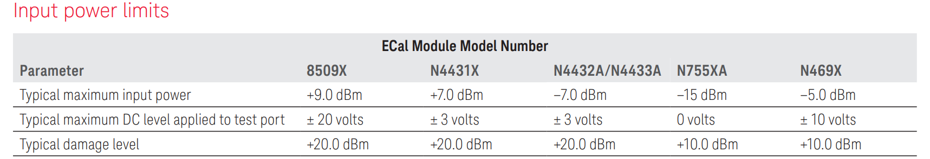
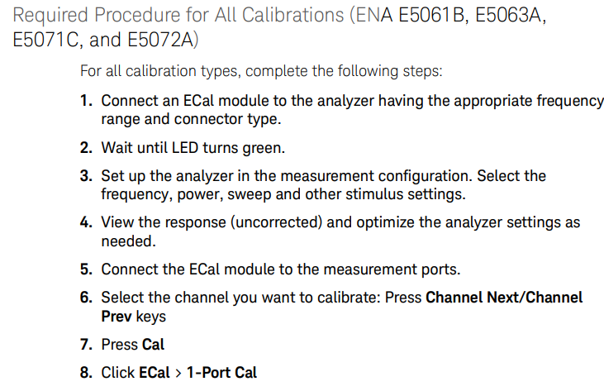
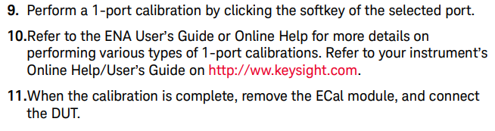
20-05-2025
1-port calibration
https://assets.testequity.com/te1/Documents/pdf/keysight/N7550A-to.pdf

Slide 6
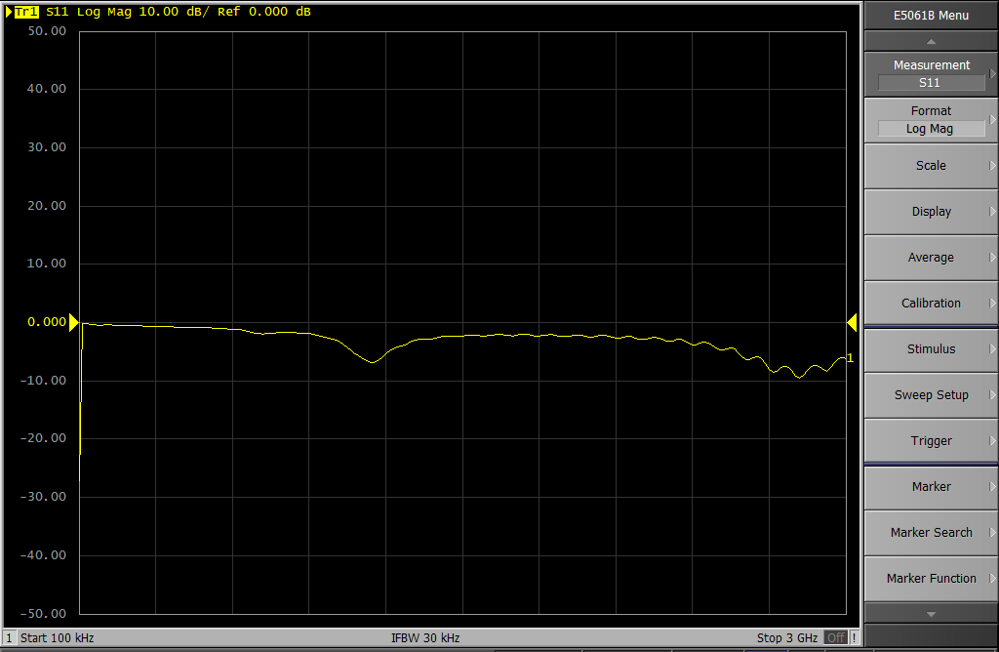
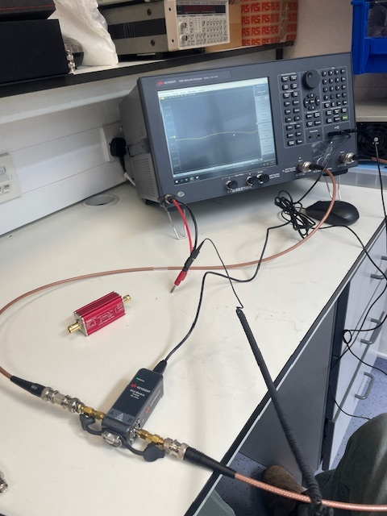

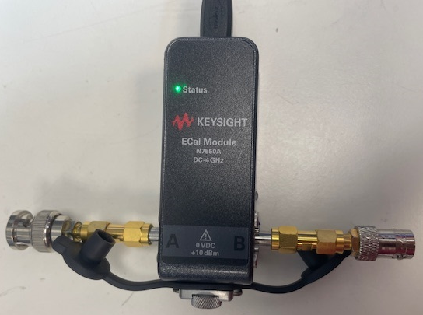
21-05-2025
2-port calibration using ECal
1) Connect the ECal to the VNA. Port1 → Ecal port A, VNA Port 2 → Ecal port B
Ground yourself when handling the Ecal unit to avoid any ESD damage!!
S11 parameter for a low pass filter DC→2.5 MHz

Slide 7
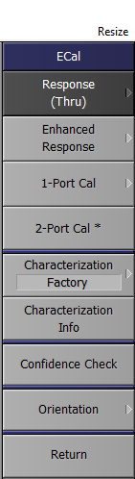
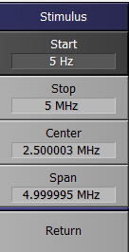
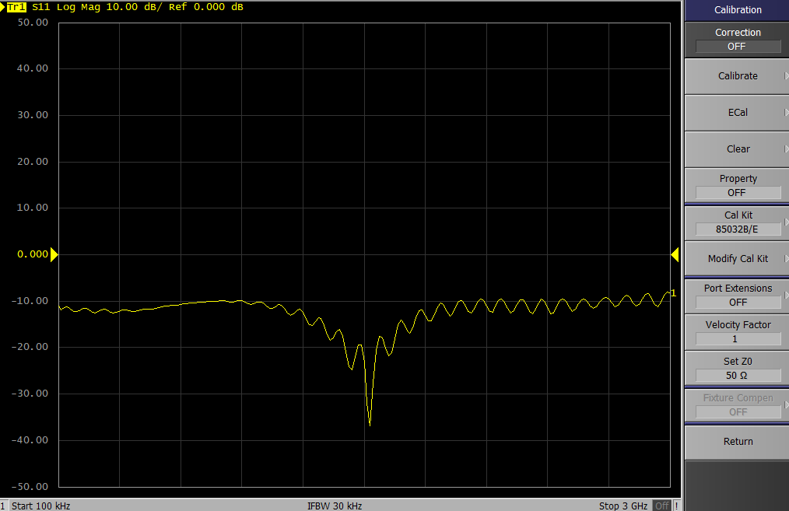
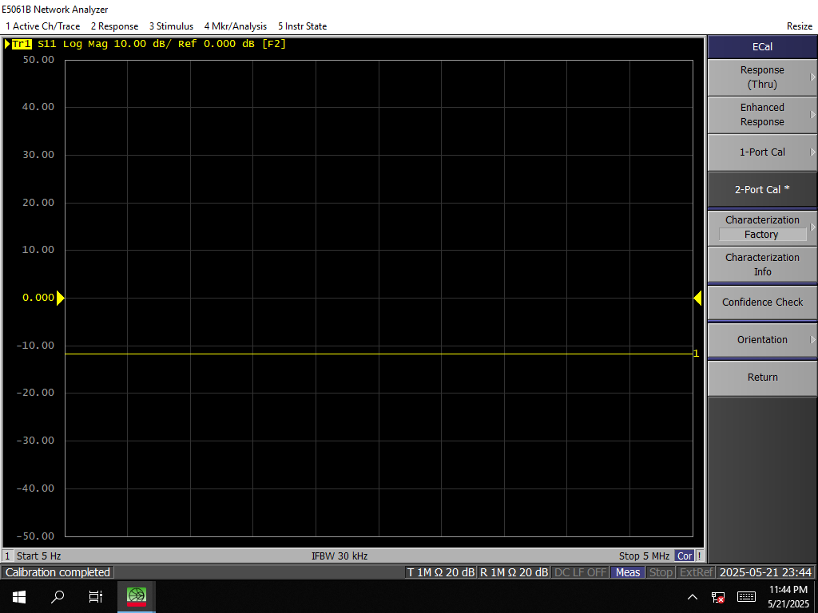
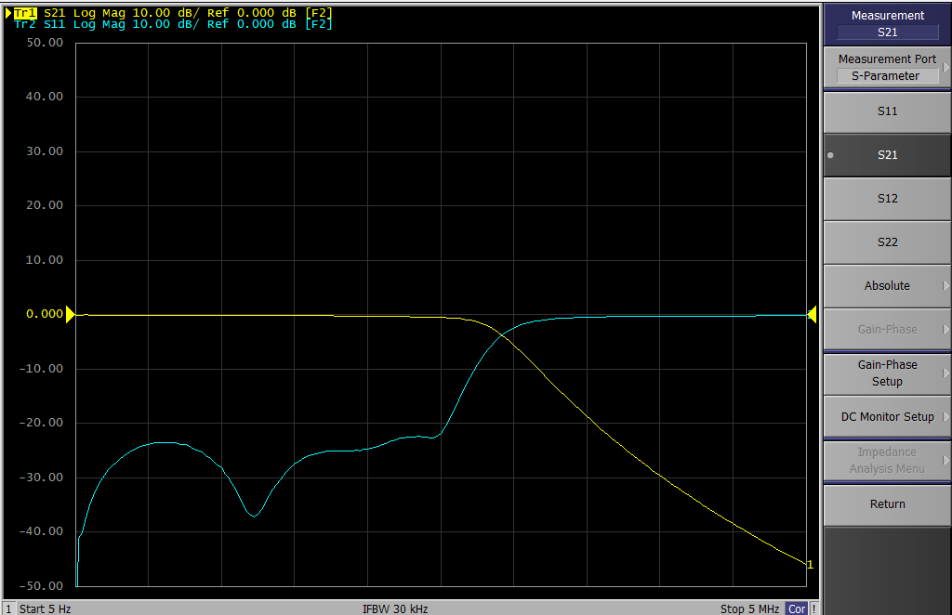
21-05-2025
2-port calibration using ECal
3) Press the ‘cal’ hard key to get this menu on the screen and select Ecal.
4) Select ‘2-port cal’
5) Once calibration is complete you should see flat line for S11, the more negative the better.
6) Once calibration is complete you should see a smooth function for S11, and the inverse for S21, when the Ecal is disconnected and the low pass filter is replaced.
2) Select frequency range of interest using the start and stop hard keys. For the low pass filter I am testing on:
Start = 5 Hz
Stop = 5 MHz

Slide 8
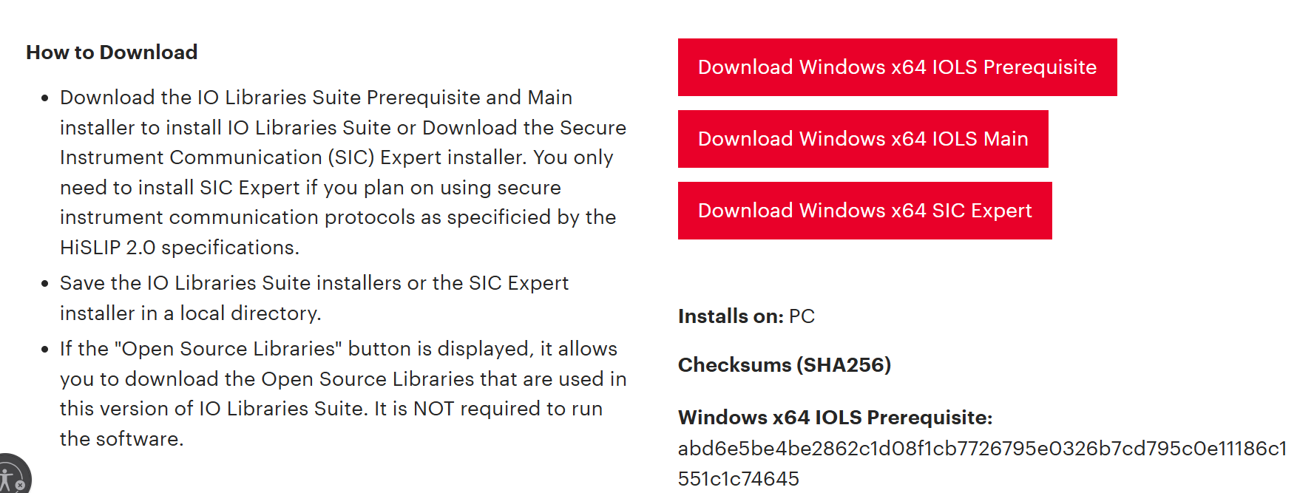
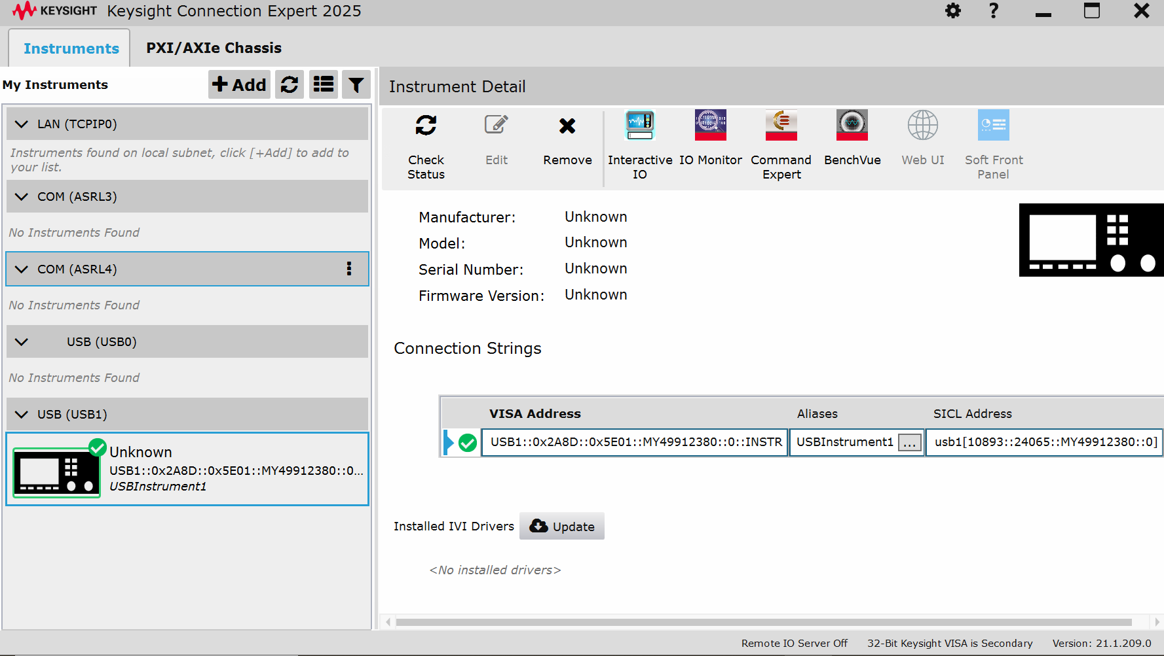
22-05-2025
Connecting via USB
https://www.keysight.com/us/en/lib/software-detail/computer-software/io-libraries-suite-downloads-2175637.html

Slide 9
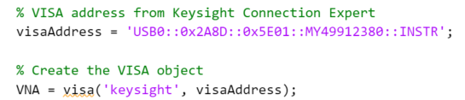




2025-05-27
Setting up MATLAB
SCIP commands can be found here: https://helpfiles.keysight.com/csg/e5061b/programming/command_reference/index.htm
← Visa address from the keysight connection expert
← Setting the scan range & number of points
← Measuring the S11 param & initiating the sweep
Fetching the S11 data
Pause required to give the VNA time to respond to the fetch request
Get the corresponding frequency data
Turning the data into numbers that we can process and plot
https://github.com/PoppyJoshi/VNA_remoteControl

Slide 10
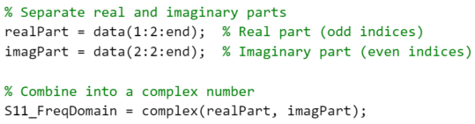
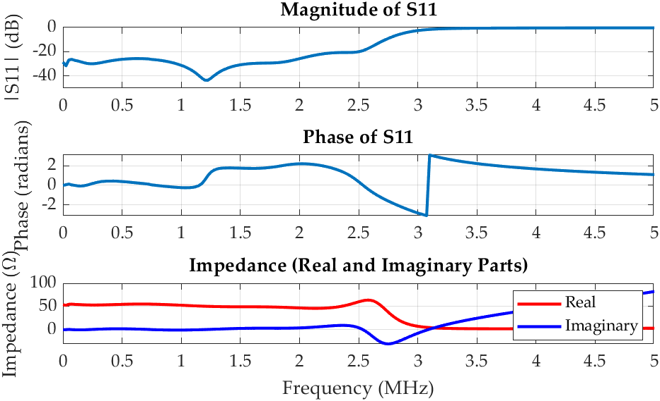
2025-05-27
Setting up MATLAB
Getting real and imaginary parts from the ‘data’ array
Make into complex number
|S11| in db
Calculating Impedance

Slide 11
